Slide 1
Mastering System Design
Section 4: Architectural Patterns
System Design Fundamentals

Slide 2
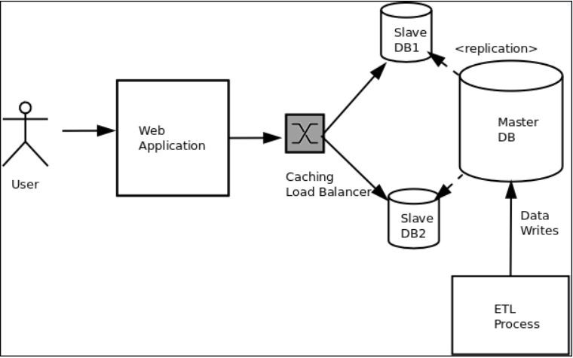
What is Software Architecture?
Deﬁnition: The structure of a system, including its components and relationships.
Why It Matters: Architecture impacts scalability, performance, and maintainability.
Importance in System Design & Key Design Considerations
  Scalability: Ability to handle increased data or
traﬃc.
  Maintainability: How easily the system can be updated or modiﬁed.
  Performance: Eﬃciency and responsiveness
under load.
"Keep in mind, the architectural choices you make directly inﬂuence system behavior."

Slide 3
Section Agenda
Introduction to Architectural Patterns
Software Architecture Patterns & Styles
Multi-Tier Architecture
Microservices Architecture
Event-Driven Architecture
Summary & Practical Applications

Slide 4
Software Architecture Patterns & Styles
System Design Fundamentals - Architectural Patterns

Slide 5
What is Software Architecture?
Deﬁnition: The high-level structure of a software system, deﬁning components, their relationships, and the way they interact.
Why It Matters: It impacts
scalability, maintainability, performance, and system behavior.
Common Architectural Styles
  Monolithic
  Layered (N-tier)
  Client-Server
  Microservices
  Event-Driven

Slide 6
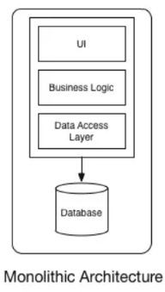
Monolithic Architecture
Deﬁnition: A single uniﬁed system where all components are tightly coupled and work as a single unit.
Pros:
  Simple to develop and deploy.
  Easier to manage in smaller applications.
Cons:
  Hard to scale.
  Diﬃcult to maintain as the codebase grows.
  High risk of failure: A single bug can take down the entire system.
Use Cases: Small-scale applications, startups,
simple CRUD-based apps.

Slide 7
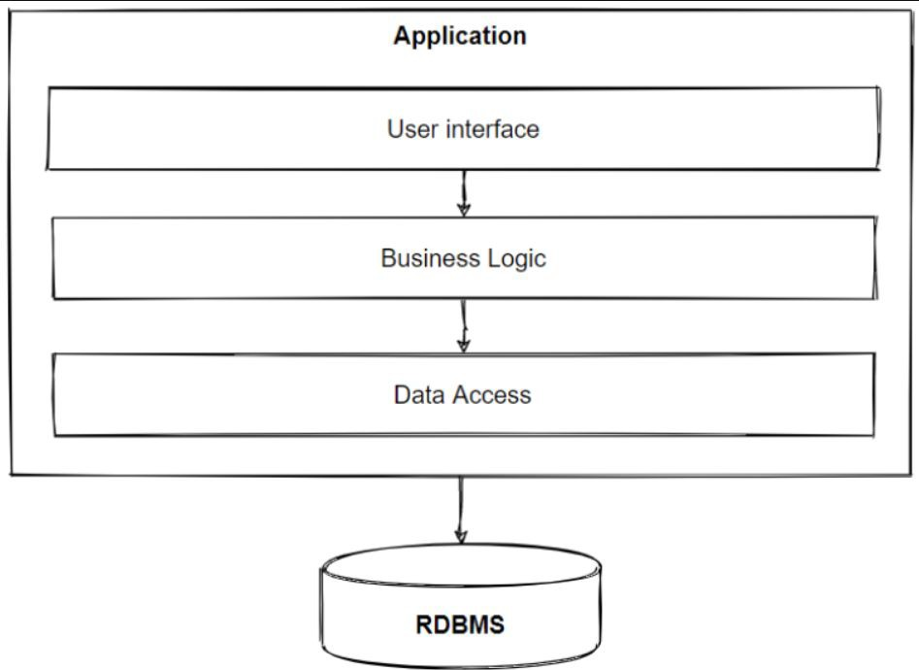
Layered (N-Tier) Architecture
Deﬁnition: A system split into multiple layers (e.g., Presentation, Business Logic, Data) to separate concerns.
Pros:
  Clear separation of concerns.
  Easier to scale and maintain compared to monolithic.
Cons:
  Performance overhead due to layers.
  May result in tight coupling between certain layers.
Use Cases: Enterprise applications, CRM
systems, Banking applications.

Slide 8
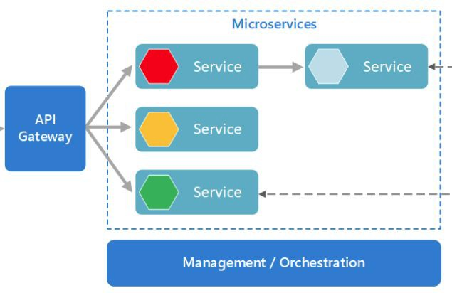
Microservices Architecture
Deﬁnition: A system built as a collection of small, independent services, each focused on a speciﬁc business capability.
Pros:
  Independent services can be scaled, deployed, and developed separately.
  Flexibility in technology stack for each service.
  Better fault tolerance.
Cons:
  Increased complexity in communication and coordination.
  Need for robust DevOps and automation pipelines.
Use Cases: Large-scale applications, e-commerce platforms, modern cloud-based systems.

Slide 9
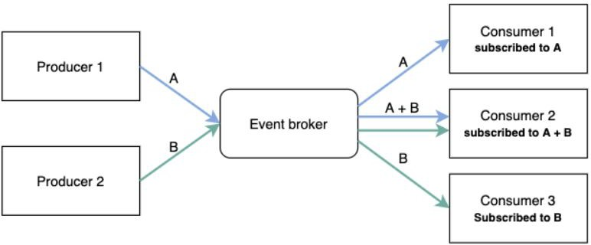
Event-Driven Architecture
Deﬁnition: A system where components communicate through events (messages) instead of direct calls, enabling loose coupling.
Pros:
  Highly decoupled architecture.
  Excellent for handling asynchronous workﬂows.
  Better scalability for high-traﬃc systems.
Cons:
  Debugging and tracing become more complex.
  Diﬃcult to ensure data consistency across services.
Use Cases: Real-time systems, IoT applications, ﬁnancial trading platforms.

Slide 10
Factors Inﬂuencing Architecture Selection
Business Needs: What problem are we solving? What is the business goal?
Scalability: How much traﬃc and data should the system handle?
Performance: How fast should the system respond to users?
Maintainability: How easy is it to make updates, ﬁx bugs, and evolve the system over time?

Slide 11
Interview questions
What is the diﬀerence between Monolithic and Microservices architecture?
When would you choose a Layered architecture over Microservices?
What are the pros and cons of Event-Driven Architecture?
How does architecture impact system scalability and performance?
How do business requirements inﬂuence architectural decisions?
Can you explain the key diﬀerences between Layered and Client-Server architectures?
What are the main challenges in maintaining a Monolithic system as it grows?
How do you decide between Monolithic and Microservices for a new system?
What role does fault tolerance play in Microservices architecture?
How do event-driven systems handle real-time data?

Slide 12
Summary & Key Takeaways
Understand diﬀerent architectural styles: Monolithic, Layered, Client-Server, Microservices, Event-Driven.
Each style has its pros, cons, and best-use cases.
Architecture decisions impact scalability, performance, maintainability, and system behavior.
Choose architecture based on business needs, technical requirements, and scalability goals.
Whats next:
  Multi-Tier Architecture

Slide 13
Multi-Tier Architecture
System Design Fundamentals - Architectural Patterns

Slide 14
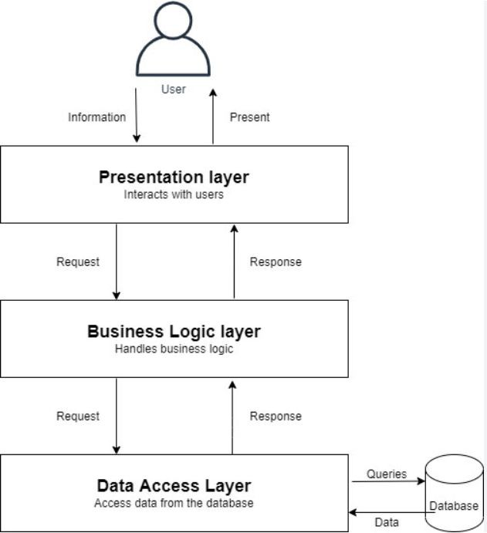
What is Multi-Tier Architecture?
Multi-Tier Architecture is a software design pattern that structures applications into multiple layers, each responsible for speciﬁc functions. This separation enhances scalability, maintainability, and security.
Key Points:
  Organizes applications into independent layers
  Separates concerns: UI, business logic, and data storage
  Enables better scalability, performance, and security
  Used in web applications, enterprise systems, and cloud architectures

Slide 15
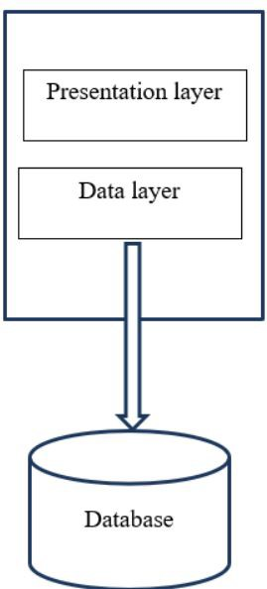





2-Tier Architecture
Deﬁnition: The 2-Tier Architecture consists of a Client Layer and a Database Layer. The client interacts directly with the database, without an intermediate business logic layer.
How It Works:
  Client Layer: User interface, application logic
  Database Layer: Stores and retrieves data
  Data ﬂows directly between the client and the database
Pros:
●
Simple to implement
Fast for small-scale applications
Cons:
  Poor scalability (limited to a few users)
  Security risks (direct database access)
Example Use Case:
●
A desktop application directly querying an SQL database

Slide 16

3-Tier Architecture
Deﬁnition: 3-Tier Architecture introduces a middle layer (Business Logic Layer) between the UI and the database.
How it works:
  The frontend interacts with the business logic layer (API Server).
  The business logic layer processes requests and
communicates with the database.
Pros:
  Improves scalability & security.
  Better separation of concerns.
  Easier maintenance.
Cons:
  Slightly higher latency due to extra processing.
Example:
  Traditional web applications

Slide 17
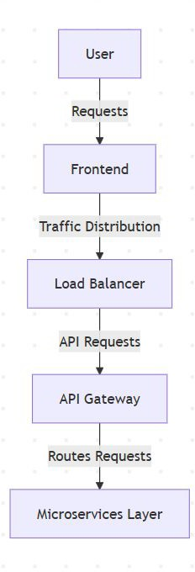
N-Tier Architecture
Deﬁnition: N-Tier Architecture extends beyond 3-Tier by adding more specialized layers like caching, API gateway, microservices, etc.
Why use N-Tier?
  Handles high-traﬃc & complex business logic.
  Allows independent scaling of diﬀerent services.
Examples:
  Microservices-based applications.
  Large-scale enterprise software.

Slide 18
Performance & Scalability Impacts
How tiers impact system performance & scalability:
  Latency Considerations:
    More layers = higher latency if not optimized.
    Solution: Caching (Redis, Memcached), Load Balancing.
  Scaling Strategies:
    Vertical Scaling (adding resources to a single server).
    Horizontal Scaling (adding more servers, distributing load).

Slide 19
Interview Questions
Basic Questions:
  What is Multi-Tier Architecture, and why is it used?
  How does a 2-Tier architecture diﬀer from a 3-Tier architecture?
  What are the key components of a 3-Tier architecture?
  Can you give an example of a real-world application that follows an N-Tier architecture?
Intermediate Questions:
  How does scalability improve in a multi-tier system?
  What are the challenges of adding more tiers in an application?
  How does load balancing work in an N-Tier architecture?
  What strategies can be used to reduce latency in a multi-tier application?
Advanced Questions:
  In a large-scale system, when would you choose microservices over a traditional N-Tier architecture?
  How would you secure inter-tier communication in a distributed multi-tier system?
  How would you design a fault-tolerant multi-tier system for a high-traﬃc application like Netﬂix or Amazon?

Slide 20
Summary & Key Takeaways
Multi-Tier = Better Scalability & Maintainability.
2-Tier is simple but limited.
3-Tier is the standard for web apps.
N-Tier is for large-scale, cloud-native systems.
What’s Next:
  Microservices Architecture

Slide 21
Microservices Architecture
System Design Fundamentals - Architectural Patterns

Slide 22
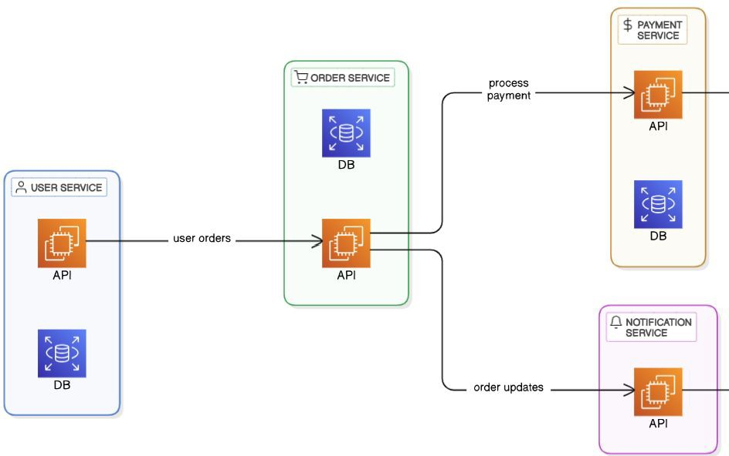

What is Microservices Architecture?
Deﬁnition: Microservices architecture is a software design pattern where applications are structured as a collection of small, loosely coupled services, each responsible for a speciﬁc function.
Characteristics:
  Independently deployable services
  Loosely coupled & modular
  Scalable & fault-tolerant

Slide 23
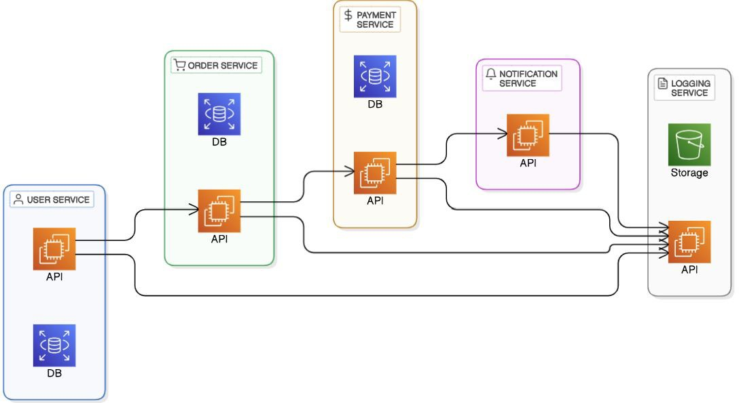
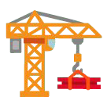
Identifying and Structuring Microservices
How to Identify Microservices?
  Business Capabilities: Each service should align with a speciﬁc business function (e.g., Payments,
Orders, Users).
Single Responsibility Principle: A microservice should do one thing well.
Data Ownership: Each microservice owns its own
database—avoid shared databases.
Independently Deployable: Should be deployable and scalable without aﬀecting others.
○
○
●
How to Structure Microservices?
Decompose by Business Domain: Use Domain-Driven Design (DDD) to group services logically.
Deﬁne Clear APIs: Services should communicate via
well-deﬁned APIs (REST, gRPC, or events).
Choose the Right Granularity: Avoid making microservices too large (monolith-in-disguise) or too small (high complexity).
Implement Observability: Use logging, monitoring, and
tracing to track service interactions.

Slide 24
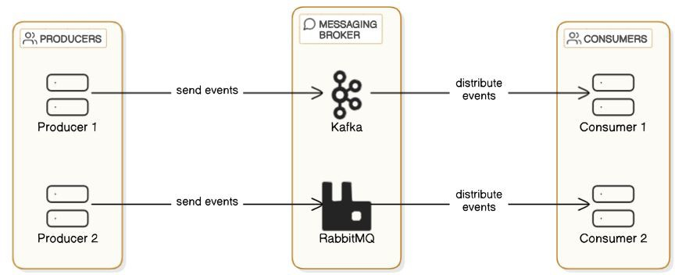
Communication in Microservices
Synchronous Communication:
  REST APIs (Simple, widely used, but high latency)
  gRPC (Eﬃcient, binary format, better performance)
Asynchronous Communication:
  Event-Driven Messaging (Kafka, RabbitMQ, SNS/SQS)

Slide 25
Challenges of Microservices
Data Consistency: Distributed databases → Eventual consistency
Distributed Tracing: Diﬃcult to debug & track requests
Network Overhead: More API calls → Increased latency
Security: Authentication, authorization, data protection

Slide 26
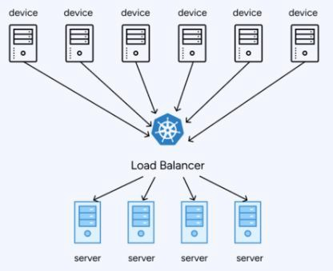
Scaling Strategies in Microservices
Horizontal Scaling: Add more instances of a service
Auto-scaling: Scale up/down automatically
Sharding & Database Scaling: Split databases for high-traﬃc services

Slide 27
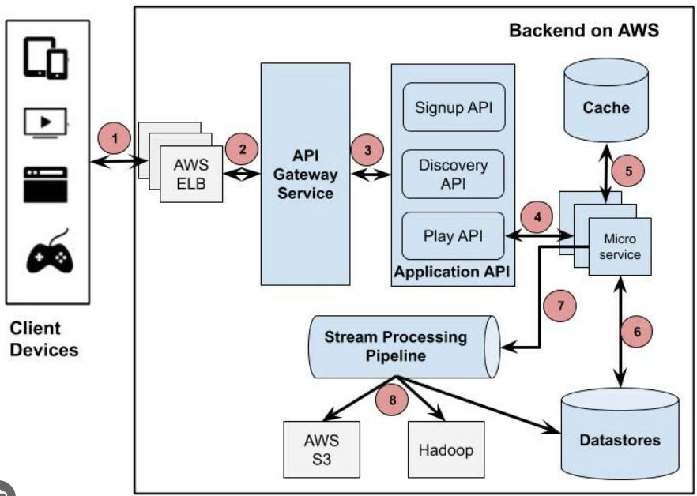
Real-World Examples of Microservices
Netﬂix: Uses microservices for video streaming & personalization
Uber: Scales ride-matching,
payments, and navigation independently
Amazon: Each service (search, payments, recommendations) runs separately

Slide 28
Interview Questions on Microservices
What are microservices, and how do they diﬀer from monolithic architecture?
What are the beneﬁts and challenges of microservices?
Explain the role of an API Gateway in a microservices system.
How do microservices communicate with each other?
How can you ensure data consistency in a microservices-based system?

Slide 29
Summary & What’s Next
Microservices = Scalability, Fault Tolerance, Faster Development
Requires API Gateway, Service Discovery, Load Balancing
Challenges: Data consistency, debugging, deployment complexity
Real-world usage: Netﬂix, Uber, Amazon
Next Lecture:
  Event-Driven Architectures!

Slide 30
Event-Driven Architecture
System Design Fundamentals - Architectural Patterns

Slide 31
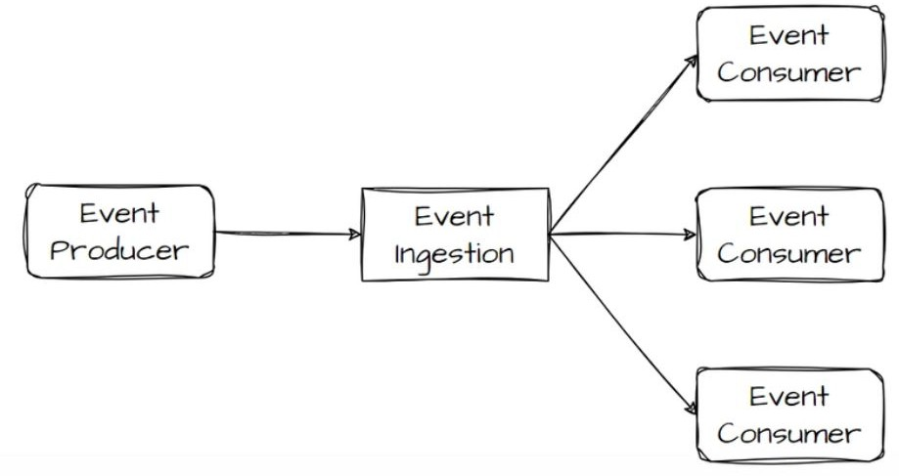
Introduction to Event-Driven Architecture
Deﬁnition: A system design where components communicate through events rather than direct calls.
Key Characteristics:
  Asynchronous processing
  Loose coupling
  Scalability & ﬂexibility
Why Use It?
  Enhances system responsiveness
  Enables real-time event processing
  Supports complex workﬂows

Slide 32
Synchronous vs. Asynchronous Systems
Synchronous Communication (Request-Response Model)
  Blocking calls
  Tight coupling
  Example: Traditional HTTP APIs
Asynchronous Communication (Event-Driven Model)
  Non-blocking
  Decoupled components
  Example: Message queues & event brokers

Slide 33
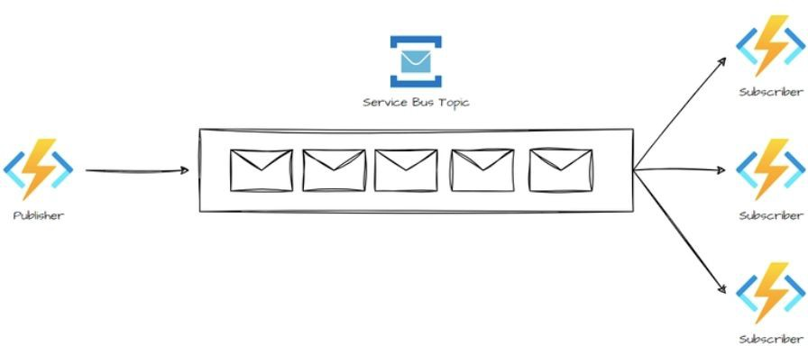
Pub-Sub vs. Event Streaming
Publish-Subscribe Model (Pub-Sub)
  Events are broadcasted to multiple subscribers
  Each subscriber gets the event once
  Example: RabbitMQ, AWS SNS
Event Streaming
  Events are stored & consumed in order
  Consumers process events at diﬀerent times
  Example: Kafka, AWS Kinesis

Slide 34
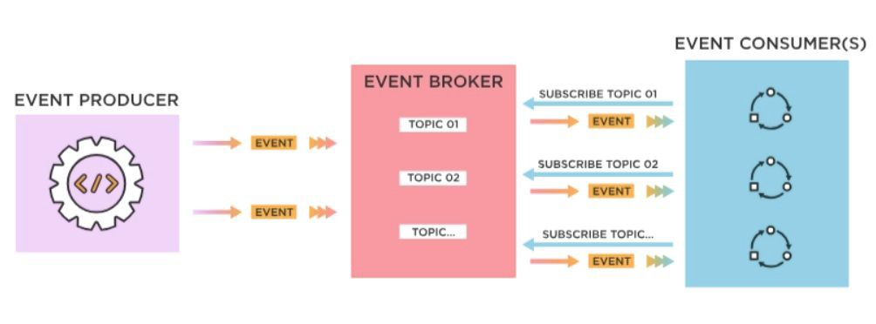
Key Components of an Event-Driven System
Event Producers (Generate events)
Event Brokers (Transmit & store events) - Examples: Kafka, RabbitMQ, AWS EventBridge
Event Consumers (React to events)
Event Storage (Log-based persistence for replaying events)

Slide 35
Challenges in Event-Driven Architecture
Eventual Consistency (No immediate data synchronization)
Ordering Guarantees (Ensuring events are processed in sequence)
Fault Tolerance & Retries (Handling failures gracefully)
Debugging Complexity (Tracing events across microservices)

Slide 36
Best Practices
Use idempotent event processing to avoid duplicates
Implement dead-letter queues for failed messages
Choose the right event broker based on system needs
Ensure event versioning to handle schema changes

Slide 37
Use Cases of Event-Driven Architecture
Logging & Auditing (Track changes over time)
Real-Time Notiﬁcations (Chat apps, stock price updates)
Microservices Decoupling (Independent scalability & fault tolerance)
IoT Systems (Sensor data processing)
E-commerce Order Processing (Order placed → Payment processed →
Inventory updated)

Slide 38
Important Interview Questions on Event-Driven Architecture
Fundamentals
  What is Event-Driven Architecture (EDA), and how does it diﬀer from traditional request-response architectures?
  Explain the diﬀerence between Pub-Sub and Event Streaming models.
  What are the key components of an event-driven system?
Scalability & Fault Tolerance
  What are some challenges of Event-Driven Architecture, and how do you handle eventual consistency?
  How can you ensure event ordering in distributed event processing?
  What are dead-letter queues (DLQs), and why are they important?
Implementation & Technologies
  What are the diﬀerences between Kafka, RabbitMQ, and AWS EventBridge?
  How do you make event processing idempotent to avoid duplicate execution?
Use Cases & Real-World Applications
  Can you give a real-world example where Event-Driven Architecture is a better choice than a traditional architecture?
  What strategies can you use to handle schema evolution in an event-driven system?

Slide 39
Summary and Key takeaways
Event-driven architecture is key to building scalable, real-time, and decoupled systems.
Choosing between Pub-Sub vs. Event Streaming depends on system needs.
Architectural patterns like CQRS & Event Sourcing enhance ﬂexibility.
Challenges exist but can be mitigated with best practices.
What’s next:
  Summary - Architecture patterns

Slide 40
Section Summary - Architectural Patterns
Architectural Patterns in System Design
  Explored diﬀerent architectural patterns and their trade-oﬀs.
  Multi-Tier Architecture: Layered approach for scalability and separation of concerns.
  Microservices: Decoupled services enabling independent scaling & deployment.
  Event-Driven Architecture: Asynchronous, scalable, and loosely coupled systems.
  Learned real-world use cases, performance considerations, and best practices for choosing the right architecture.
What’s Next:
  Web Concepts in System Design

